Slide 1
TECHNICAL PROJECT
ALFIN SAM MATHEW
ENROLL.: EN12024078062
BATCH : DA132S13

Slide 2
AGENDA
Objective
Project Objective
​Analysis
Insights
​Recommendation​

Slide 3
introduction
We have to perform Exploratory data analysis. We have taken the Airbnb dataset to perform analysis.
Data Source : https://www.kaggle.com/datasets

Slide 4
Project objective
Optimize Airbnb property listings
Host performance to increase booking rates and revenue

Slide 5
analysis

Slide 6
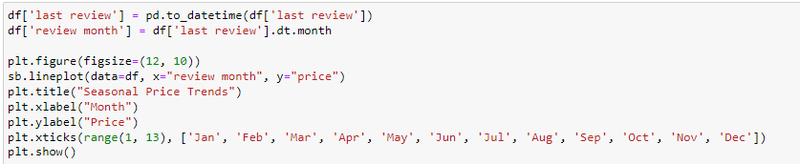
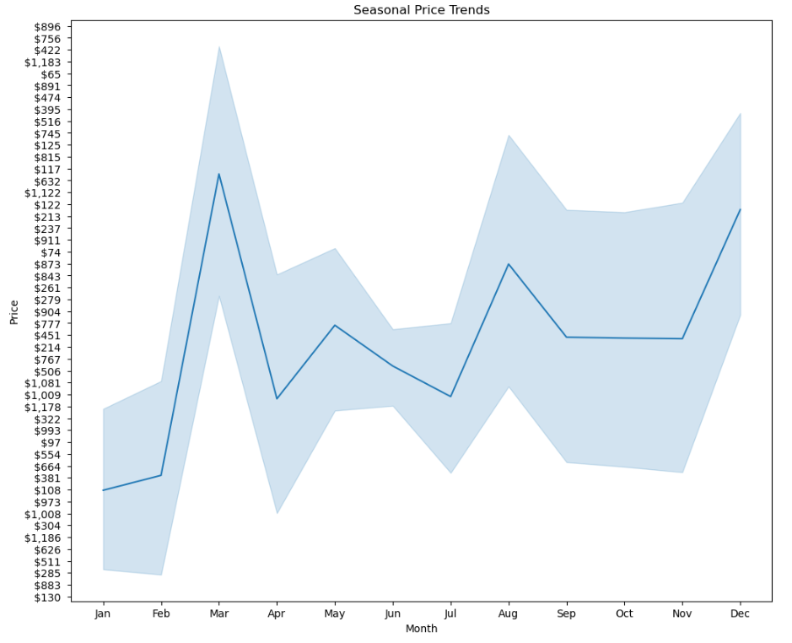
How do listing prices vary seasonally throughout the year, and can we identify peak booking periods for price optimization?
March experiences the highest peak in Airbnb listing prices, suggesting increased demand during this period, which hosts can leverage for revenue optimization strategies.

Slide 7
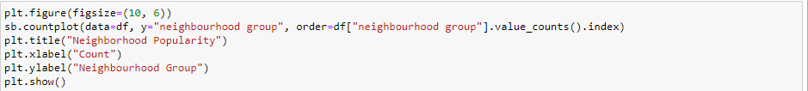
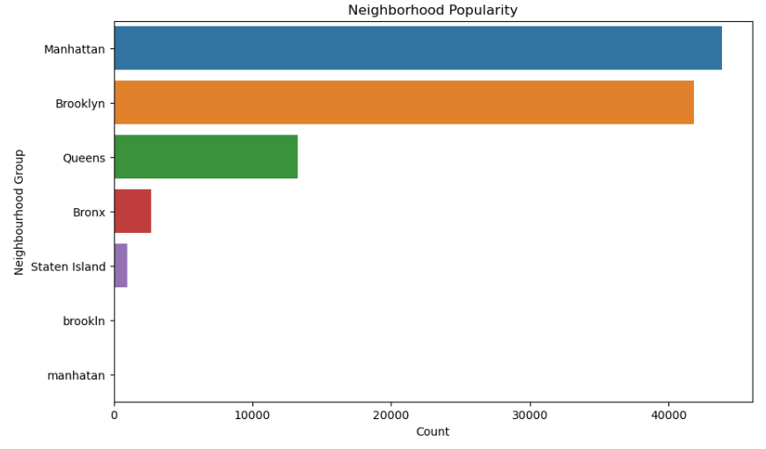
Which neighborhoods have the highest demand for Airbnb listings, and how can hosts leverage this information to increase revenue?
Manhattan is the most popular neighborhood group among Airbnb guests, indicating a high demand for accommodations in this area, which hosts can capitalize on for revenue optimization.

Slide 8
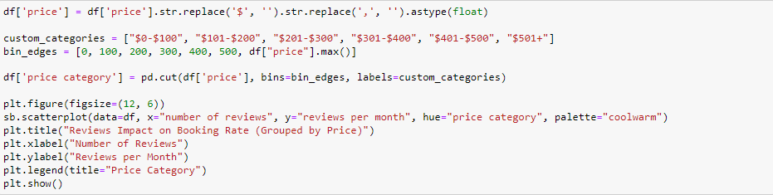
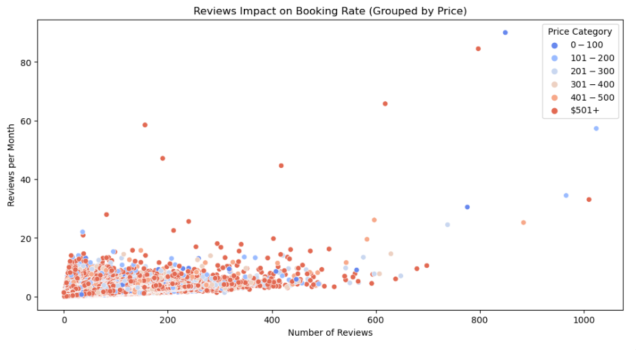
Do listings with higher numbers of reviews tend to have better booking rates and prices, and how can hosts encourage more guest reviews?
Hotels with higher review ratings and more reviews tend to have higher prices and booking rates.

Slide 9
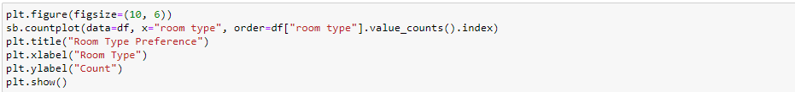
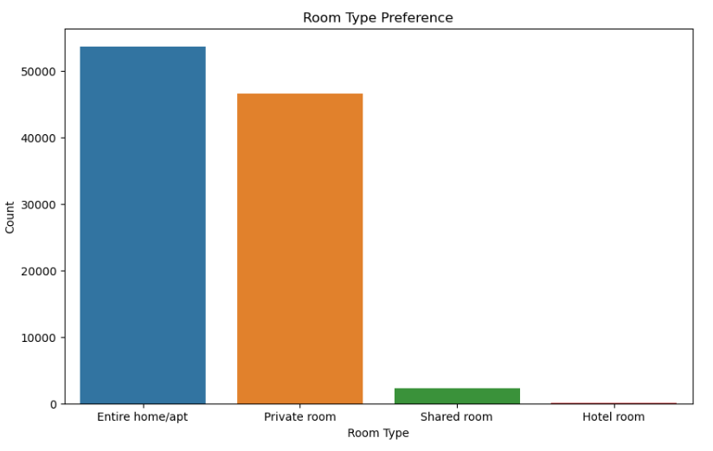
Are certain room types (private rooms, entire apartments, etc.) more popular among guests, and how can hosts adjust their offerings to align with preferences?
Guests have a strong preference for booking entire home/apartment listings on Airbnb, as indicated by the significantly higher count for this room type.

Slide 10
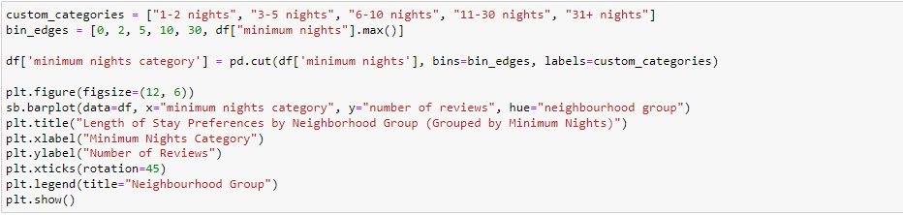
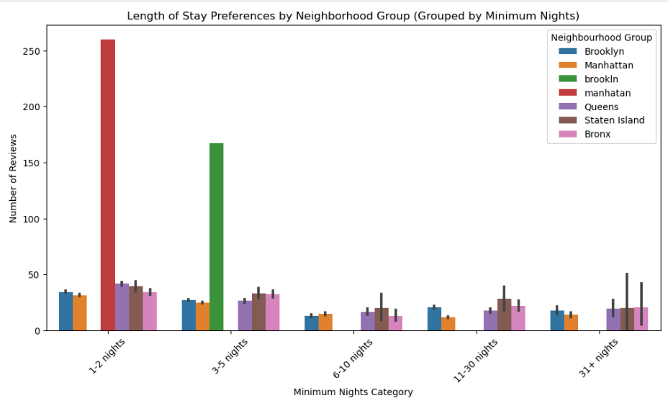
What are the length of stay preferences among guests within different neighborhood groups and how can hosts tailor their listings to accommodate these preferences to increase bookings and revenue?
For 1-2 night stay, most people prefer Manhattan and for 3-4 nights people prefer Brooklyn.

Slide 11
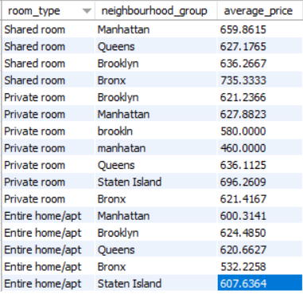
What is the average price for each combination of room type and neighborhood group??
The pricing for shared rooms is highest in the Bronx and lowest in Queens, while private rooms have varying prices across different neighborhoods, with the highest average price in Staten Island and the lowest in Brooklyn. For entire home/apartment listings, Manhattan has the highest average price, followed by Brooklyn and Queens, with the Bronx having the lowest average price.

Slide 12

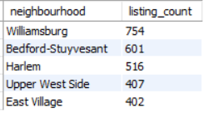
Which neighborhoods have the highest number of listings?
The neighborhoods with the highest Airbnb listing counts are Williamsburg and Bedford-Stuyvesant, followed by Harlem, Upper West Side, and East Village.

Slide 13
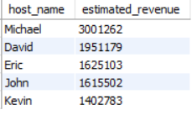
What is the estimated revenue generated by each host based on the number of reviews and the average price of their listings?
Hosts named Michael have the highest revenue, followed by David, Eric, John, and Kevin, in descending order of revenue.

Slide 14
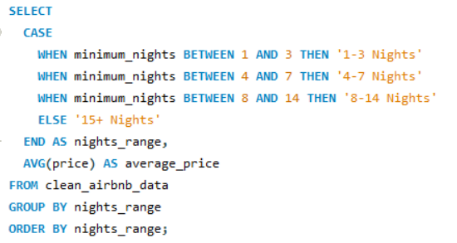
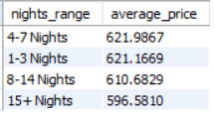
What is the average price for listings based on different ranges of minimum nights required for booking?
Hosts named Michael have the highest revenue, followed by David, Eric, John, and Kevin, in descending order of revenue.

Slide 15
iNSIGHTS
March experiences the highest peak in Airbnb listing prices.
Manhattan is the most popular neighborhood group among Airbnb guests.
Guests have a strong preference for booking entire home/apartment listings on Airbnb.
The proportion of listings marked as "instant bookable" (TRUE) is roughly equal to those marked as "not instant bookable" (FALSE).
Length of stay preferences among guests vary based on neighborhood groups and grouped minimum nights categories.
Hotel rooms have the highest average pricing among room types, followed closely by shared rooms, while private rooms and entire home/apartments have similar average prices, indicating a potential pricing strategy for hosts to consider.
The highest average pricing for "Entire home/apt" listings is found in Staten Island, while the lowest average pricing for the same room type is in Queens.

Slide 16
RECOMENDATIONS
Manhattan hosts should maintain high-quality listings and consider slight price increases during peak seasons to capitalize on high demand
.Offering flexible minimum stay options of 1-2 nights can attract a wider range of guests and increase booking rates.
Hosts with higher-priced listings should prioritize excellent value and service to maintain positive reviews and justify their prices.
Emphasizing entire home/apartment listings can align with guest preferences and boost bookings.
Balancing instant bookable and non-instant bookable listings caters to different booking preferences.
Tailoring pricing and discounts based on length of stay and neighborhood group market conditions can optimize bookings and revenue.

Slide 17
THANK YOU
Alfin Sam Mathew
alfinsam123@gmail.com

